Slide 1
DECOMPOSITION

Slide 2
Agenda
Decomposition
Dependency Preservation
Lossless and Lossy decomposition
Examples

Slide 3
DECOMPOSITION
Definition :The decomposition of a schema R=A1…An is its replacement by a collection DR = {R1 , R2 , …, Rm} of subsets of R such that R = R1Ս R2 Ս … Ս Rm
Example : Assume the schema R=ABCD. The following are possible decompositions of R.
R1 = {AB, CD}
R2 = {AB, ACD}
R3 = {A, BCD}
R4 = {AB, BC, CD, AD}
Decomposition are of two types:
Lossless decomposition
Lossy decomposition

Slide 4
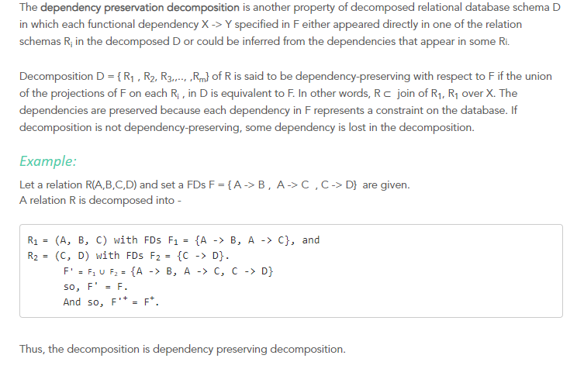
Dependency Preservation in Decomposition

Slide 5
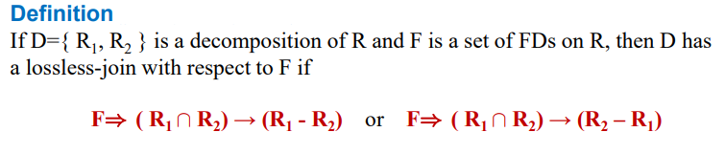

Lossless Decomposition
Example: Consider a relation R(A,B,C,D) having the FD(s), F={AB→C,BC→ D). The relation is decomposed into two relation: R1(A,B,C) and R2(B,C,D). Prove that the decomposition is lossless decomposition.
Solution:
Step 1: Create initial table, entering b_{ij} values in each cell.
i-means row index and j-means column index

Slide 6




Lossless Decomposition
Step 2: For each attribute mentioned in each partition R_{i} introduce a_{j} on column j
Decomposed Relation:
R1(A,B,C) and R2(B,C,D).
Step 3:Apply FDs to unify a_{j},b_{ij} symbols..
Using AB→C we cannot consider because, R2 consist of b₂₁ for A. But using BC→D we discover {a₂,a₃}→ {b₁₄,a₄}, hence b₁₄ can be replaced by a₄.
As the first row now has aj values in each cell. Stop!
Decomposition R1 and R2 are lossless.

Slide 7


Lossy Decomposition
Example: Consider a relation R(A,B,C,D) having the FD(s), F={B→C,D→ A). The relation is decomposed into two relation: R1(B,C) and R2(A,D). Prove that the decomposition is lossy decomposition.
Solution:
Step 1: Create initial table, entering b_{ij} values in each cell.
Step 2: For each attribute mentioned in each partition R_{i} introduce a_{j} on column j
Step 3:Apply FDs to unify a_{j},b_{ij} symbols..
Using B→C we cannot consider because, R2 consist of b₂₂ for B. We also cannot use D→A because R1 consist of b₁₄ for D.
** LHS must have similar value of a_{j} then only RHS can be changed. We cannot derive a full row with aj values- decomposition is lossy.

Slide 8
THANK YOU

